Slide 1

Weather Forecast System using Real Time API
by
ARGHYA BANERJEE
MENTOR : Prof. Shilpa Pareek
Enrollment No : 22020002001008 Sec : B Year : 3rd Year

Slide 2
CONTENTS OF THE APPLICATION
Here’s what you’ll find the features of this application:
A simple approach to weather forecast.
Current Weather Forecast.
Daily forecast.
Weather Condition.
Atmosphere.
Climate Forecast
Real time Accurate data feching
Search Bar
Geocoding

Slide 3
About the Project : Weather Forecast System
Weather Forecast System is a real time weather update application by which we can get Time to Time weather updates at anytime for any location in the world.
Weather Forecast system is made using JavaScript scripting language with HTML and CSS.
The Application is manipulated by a server which is created using Node.js
Data for the application is coming from API by the server.
This Application is runable only on Web Browser.

Slide 4






Technology Used :

Slide 5
REQUIREMENTS :
Web Browser
Node.js Runtime Enviroment
Windows 7
Express.js
Internet Connection
Any of Intel Pentium Series
10 GB of Space in Storage
1.5 GB of RAM

Slide 6
FEATURES
Real Time Weather Update.
Current Weather.
Daily Forecast for 7 days.
Climatic Forecast.
Get weather for your Location by only One Click.
Get updates for any location in the Globe.
Get Location by any City Name, Area Name.
Accurate Temperature Update & weather status
Changes weather in every seconds according to weather changes
Get Weather Conditions (Humidity, Pressure, Clouds, Wind, Status etc)

Slide 7
HOW WE’LL IMPROVE FACILITIES IN FUTURE
by adding Rode Risk prediction
Hourly & Minutly forecast
Agriculture analytics (Crop map, Recognised field boundaries , Vegetation indicies statistics by each recognised field, Climate data for regions and particular field, Soil and weather data)
Travel Plan scheduler by weather of the place.
Statistical Weather report.
Precipitation in maps & Map weather visualization
Air Pollution

Slide 8
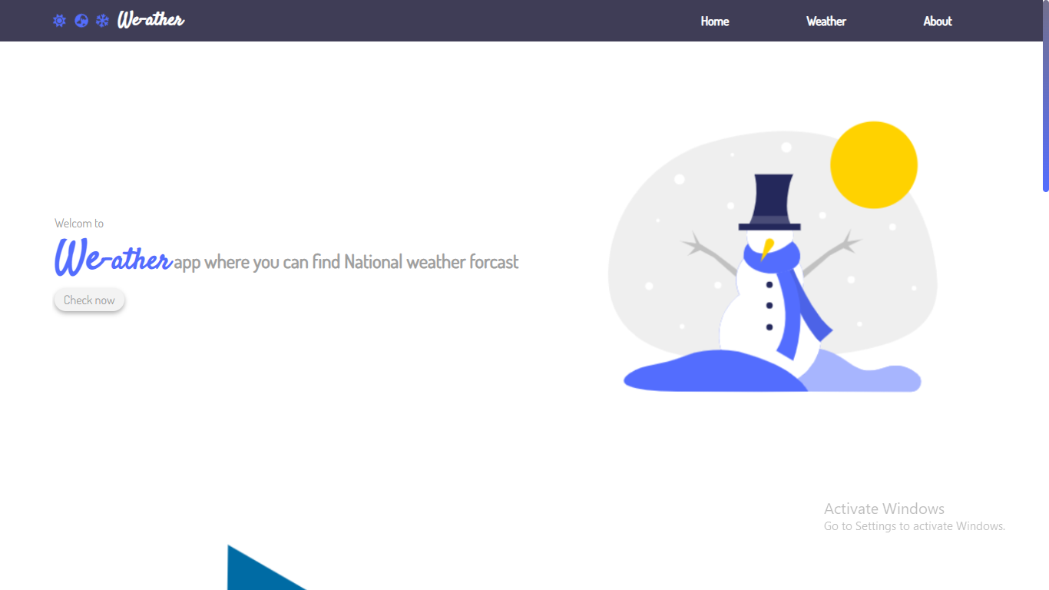
Snaps of the Weather Forecast System :
provides Real time Weather updates which is useful for any people in the world
Home
Screen

Slide 9
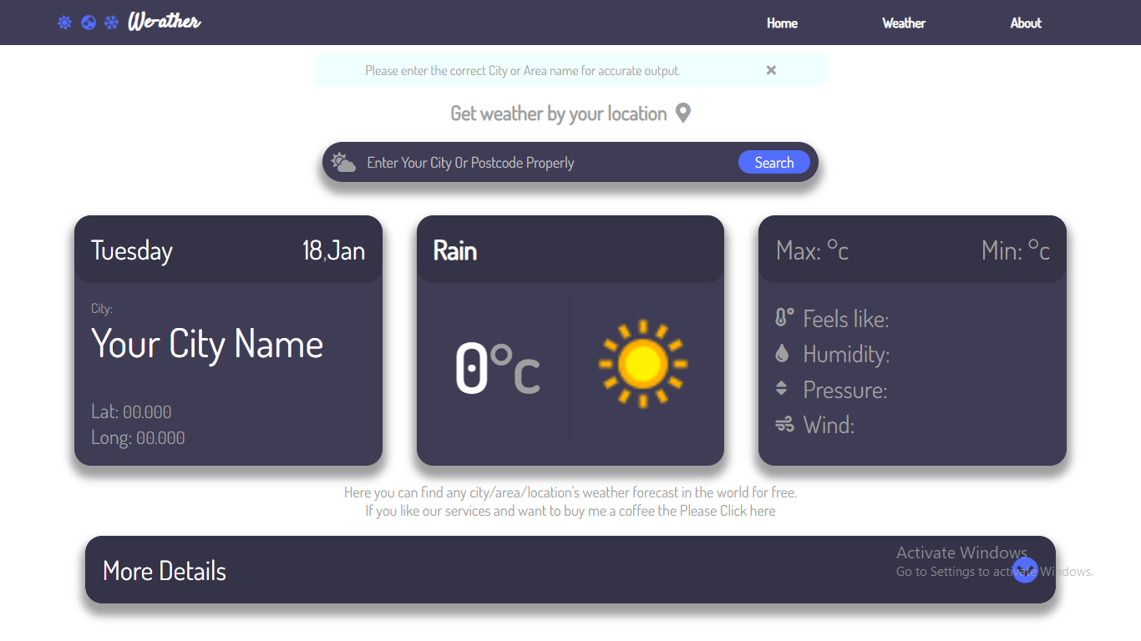
Snaps of the Weather Forecast System :
provides Real time Weather updates which is useful for any people in the world
Weather
Section

Slide 10
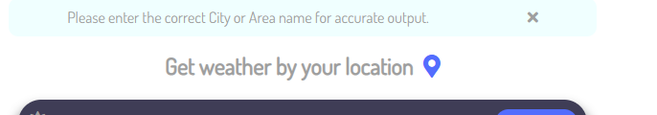

Snaps of the Weather Forecast System :
provides Real time Weather updates which is useful for any people in the world
By current Location
By SearchBar

Slide 11
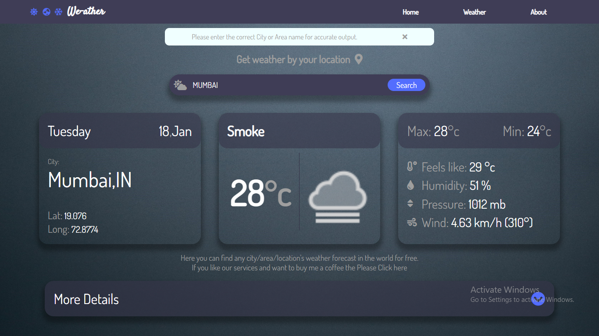
Snaps of the Weather Forecast System :
provides Real time Weather updates which is useful for any people in the world

Slide 12
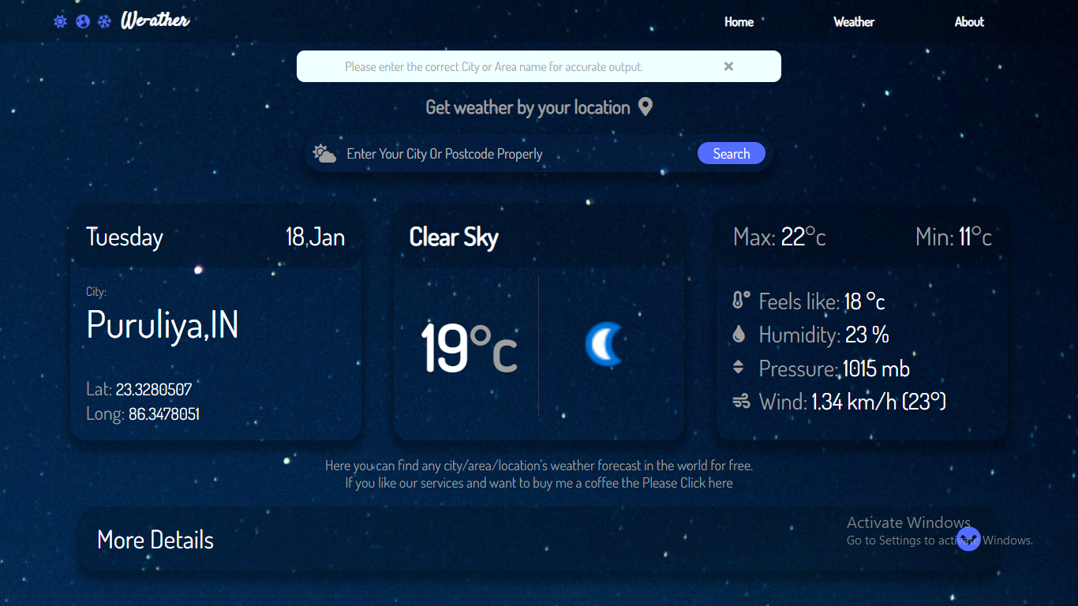
Snaps of the Weather Forecast System :
provides Real time Weather updates which is useful for any people in the world

Slide 13
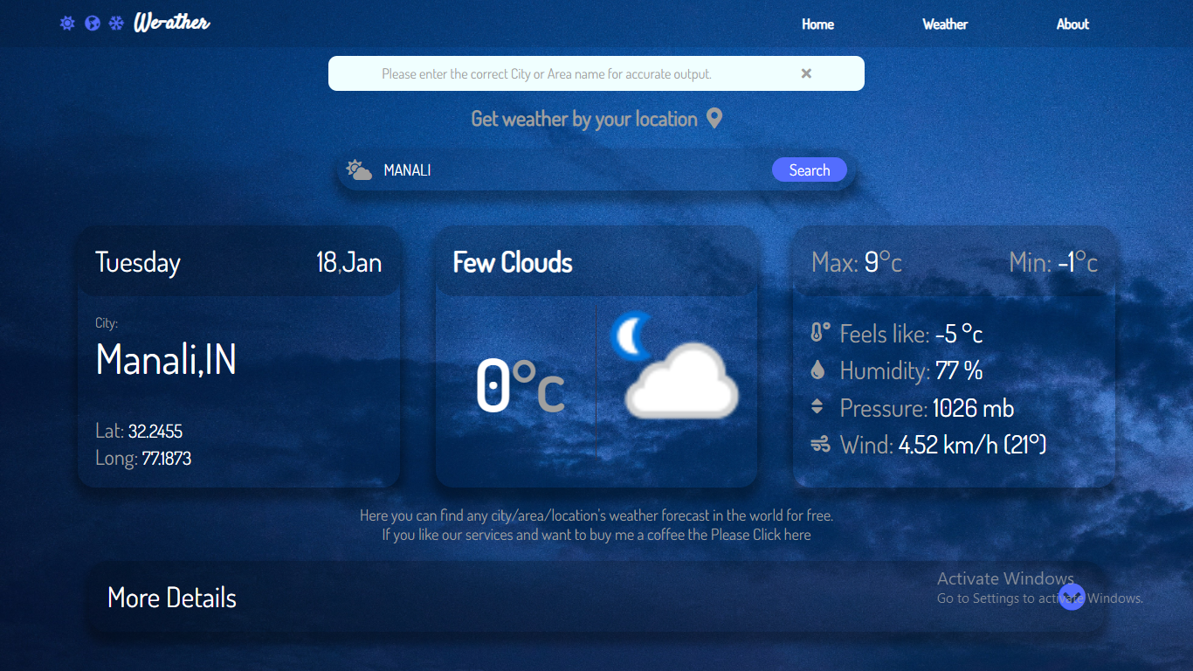
Snaps of the Weather Forecast System :
provides Real time Weather updates which is useful for any people in the world

Slide 14
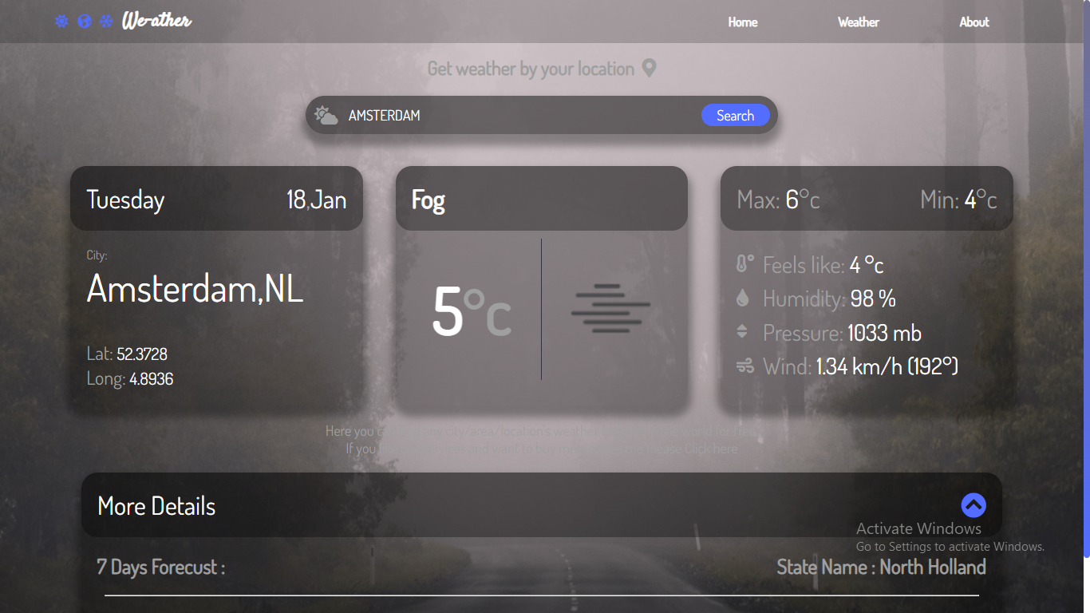
Snaps of the Weather Forecast System :
provides Real time Weather updates which is useful for any people in the world

Slide 15
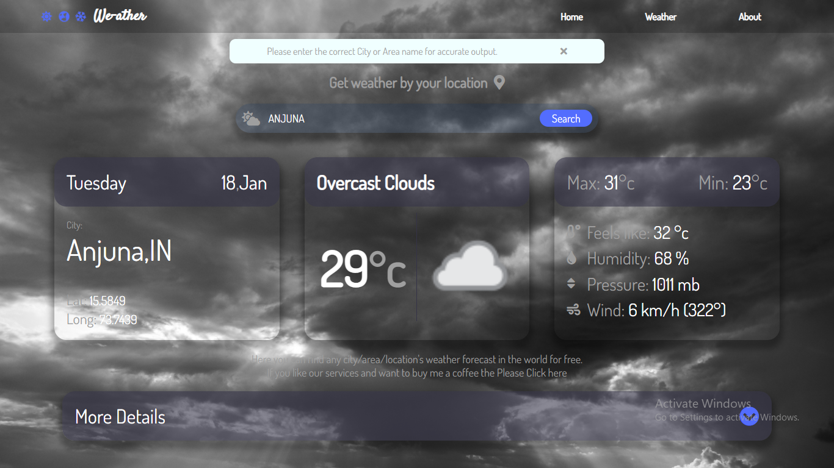
Snaps of the Weather Forecast System :
provides Real time Weather updates which is useful for any people in the world

Slide 16
THANK
YOU!!!!!

